Slide 1
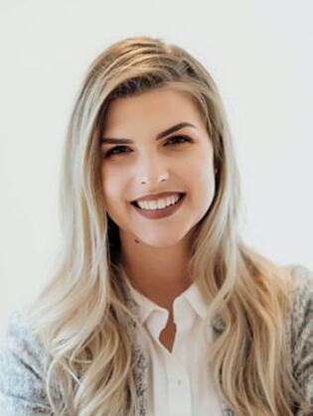
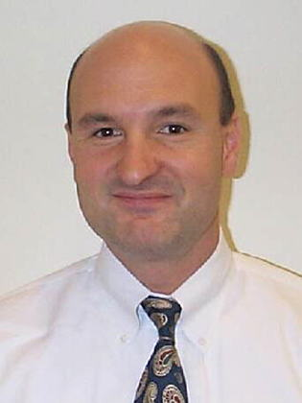
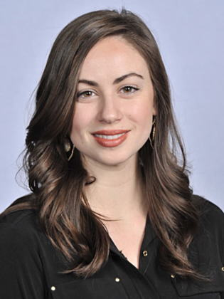
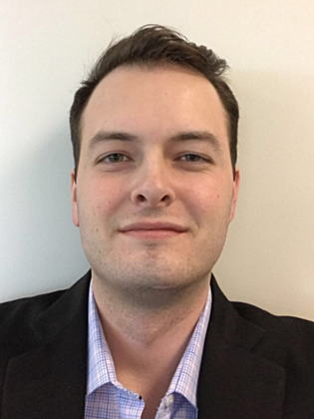
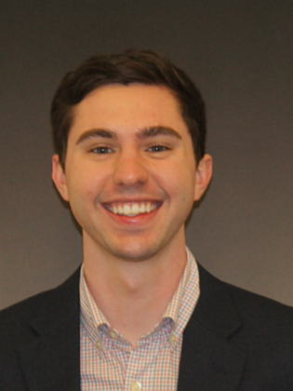
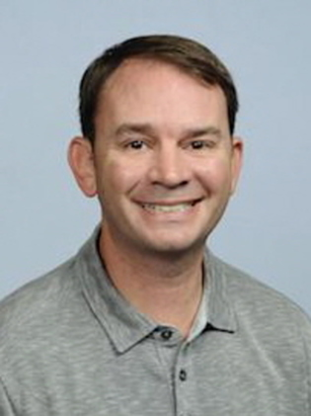
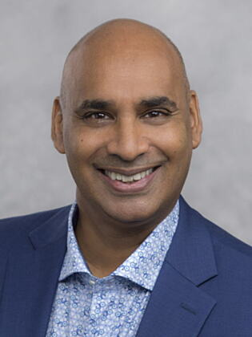
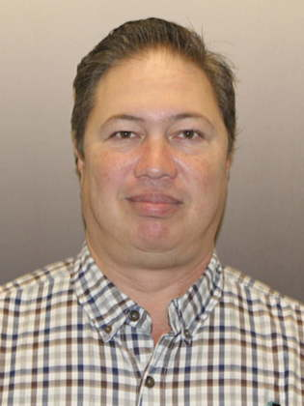
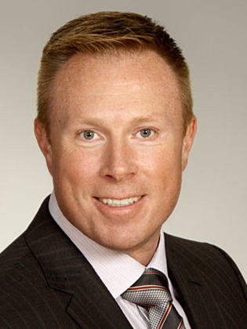
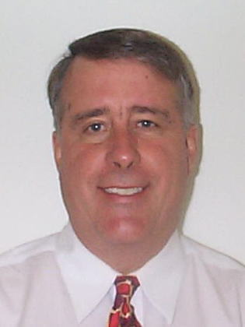
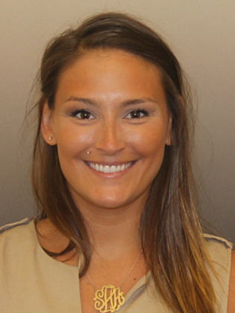
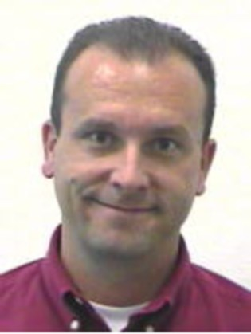
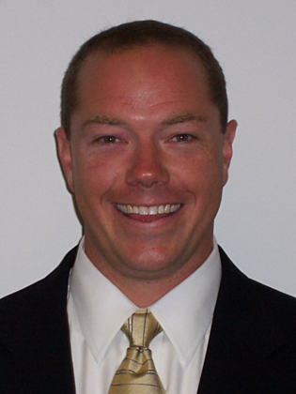
Cisco DAF Sales Team
Erika Klear
eklear@cisco.com
Account Manager
DAF Enterprise, 16th Air Force, USSTRATCOM
Alfred Ziviello
aziviell@cisco.com
Account Manager
Air Combat Command (ACC)
Katherine Yahiel
yahiel@cisco.com
Account Manager
US Space Force, NORTHCOM,
Space & Missiles Center (SMA)
Sean Jeffers
sejeffer@cisco.com
Account Manager
ABMS/JADC2, Air Force Programs, MPE (MPCO), Foreign Military Sales (FMS)
Alex Cory
alcory@cisco.com
Account Manager
Air National Guard (ANG)
Matt McCook
mmccook@cisco.com
Account Manager
Air Force Reserve
Command (AFRC),
Air Force Programs
Shiva Hiremath
shivhire@cisco.com
Account Manager
Pacific Air Forces (PACAF)
Don Rogers
donroger@cisco.com
Systems Architect
DAF Enterprise
Rob Woodrow
rowoodro@cisco.com
Account Manager
Air Force Europe (USAFE)
Kim Poineau
kpoineau@cisco.com
Account Manager
Air Force Central Command (AFCENT)
Stephanie Harper
srieper@cisco.com
Account Manager
US Space Force, NORTHCOM,
Space & Missiles Center (SMA)
Greg Halvorsen
ghalvors@cisco.com
Account Manager
Air Force Global Strike
(AFGSC)
Scott Dreher
scdreher@cisco.com
Account Manager
Air Mobility Command (AMC),
Air Force Lifecycle Management
Center (AFLCMC), USTRANSCOM
1
© 2022 Cisco and/or its affiliates. All rights reserved. For DAF Release Only.
Notes:
Number of years of service

